Slide 1
Data Visualization using R

Slide 2

Original plot by Minard (1861)
Tufte (2001) The visual display of quantitative information, p. 41

Slide 3
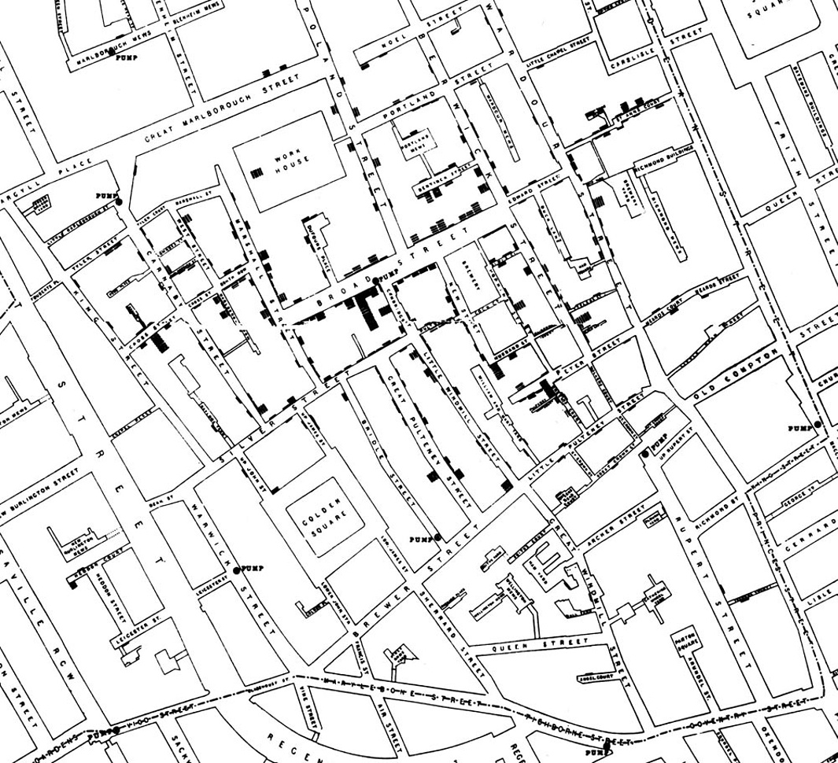

Slide 4
Format
Live coding session
Tutorial
Sticky notes
Community support
“Try stuff and see what happens”

Slide 5
Why R?
Reproducible Science!
Full data science workflow
Language & environment for statistical computing and graphics
Open source
Free
Rstudio provides support for using R
We are learning R together with RStudio and its many supporting features
NB: R is not the only solution out there

Slide 6
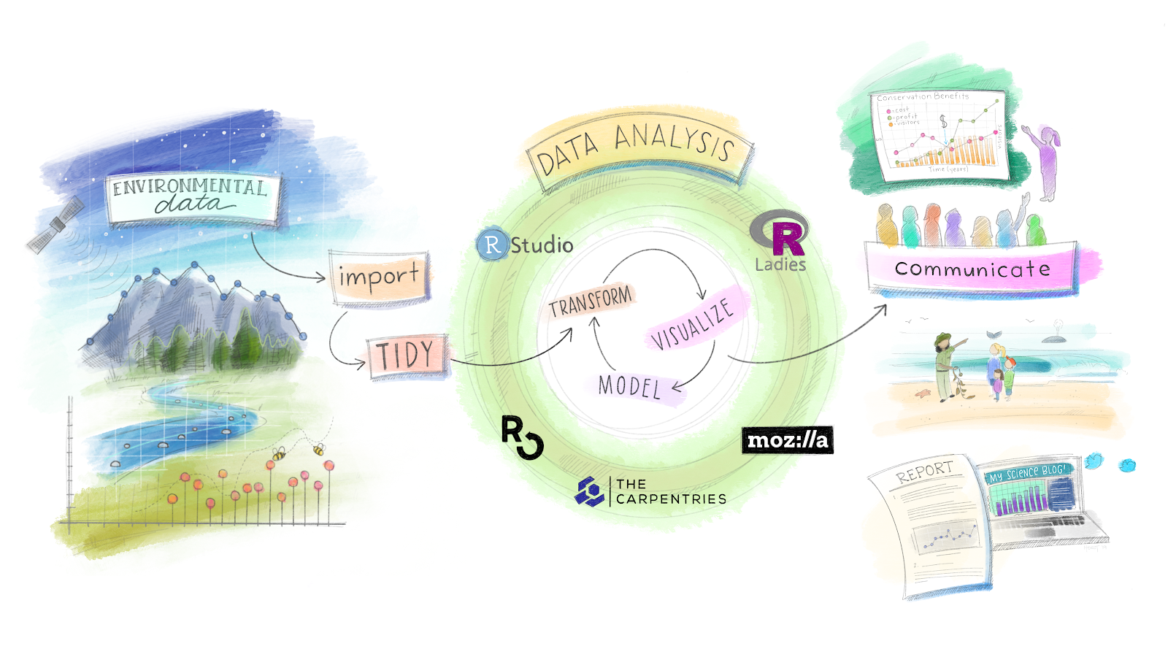
Why R?

Slide 7
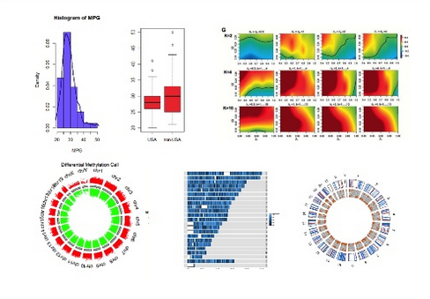
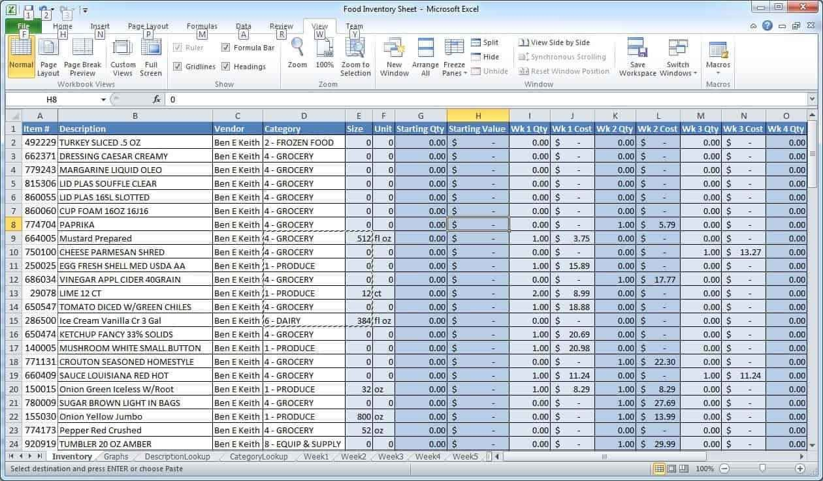

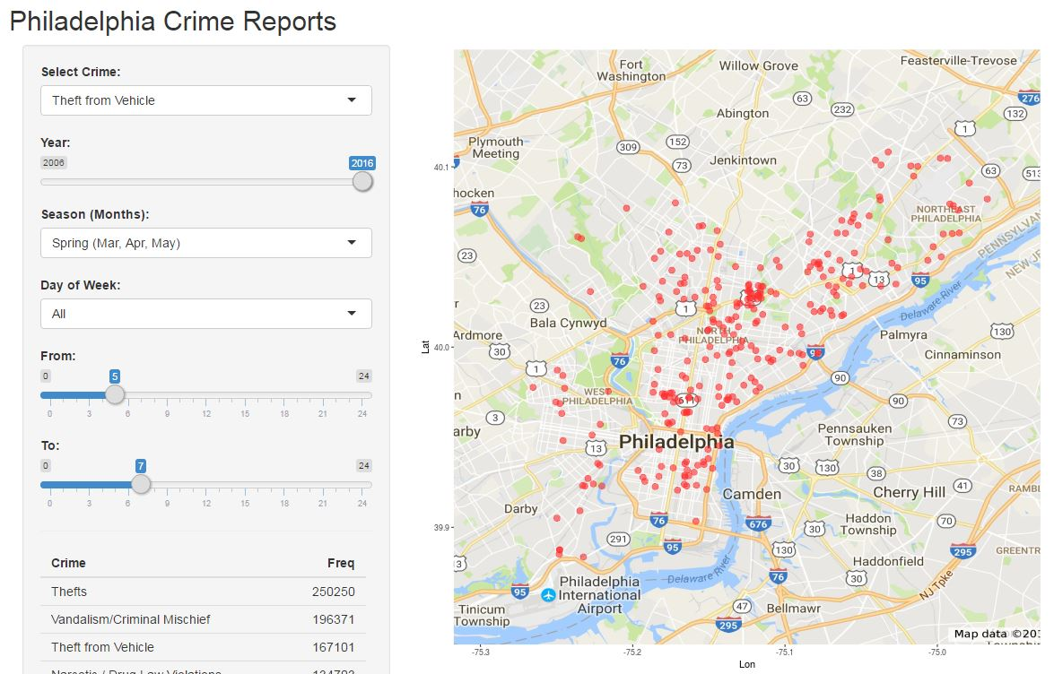
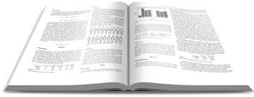
Why R?
Wickham + Grolemund (2017)

Slide 8
Using R today: Rstudio Cloud
Rstudio Cloud (web browser interface)
https://rstudio.cloud/project/134344
Go to above link and create a (free) account

Slide 9
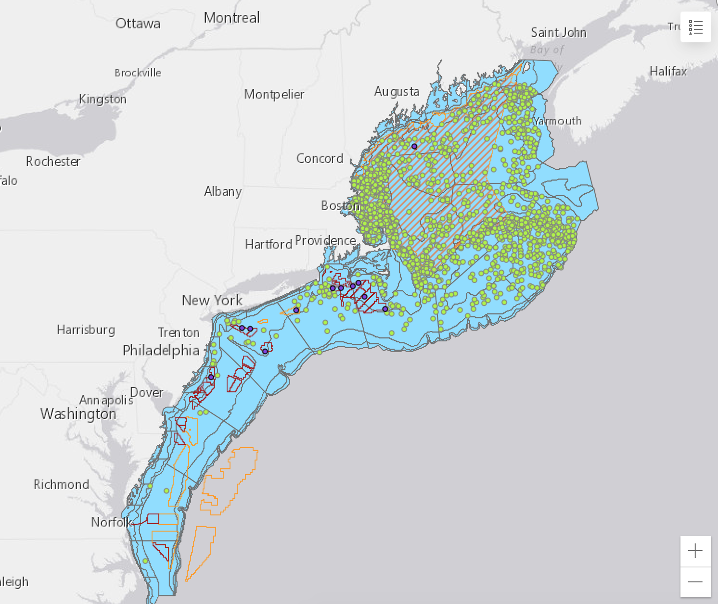
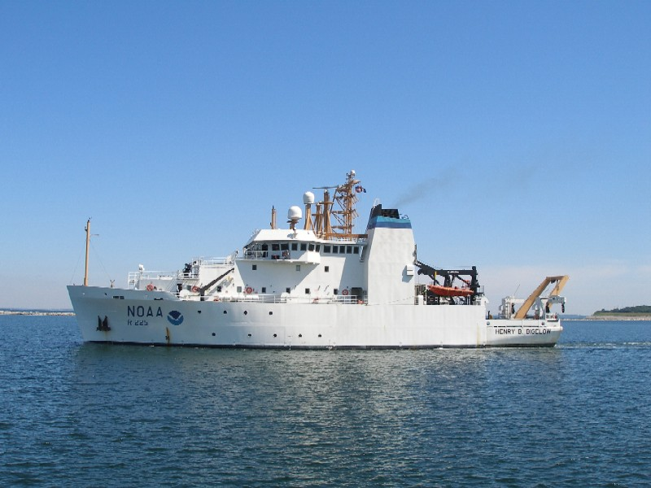
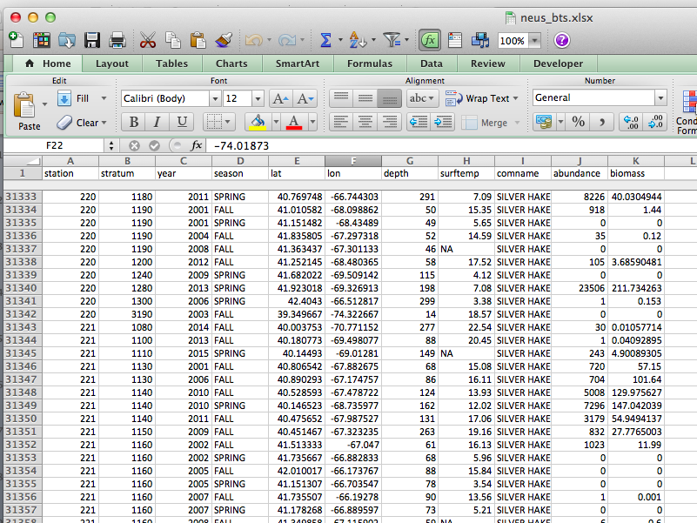
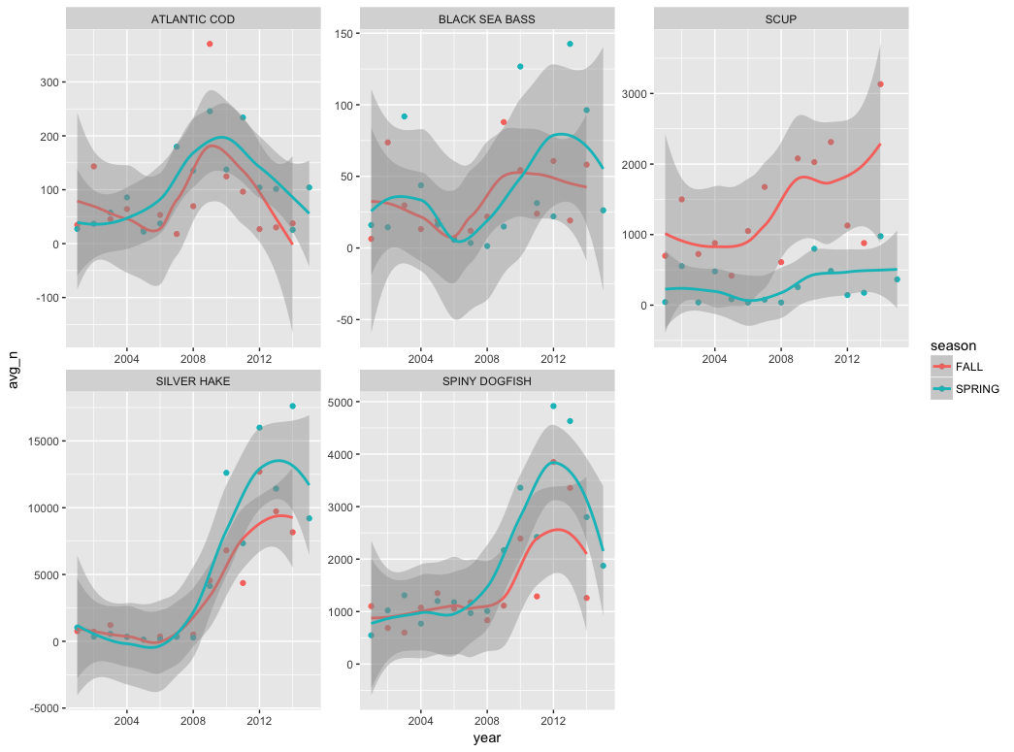
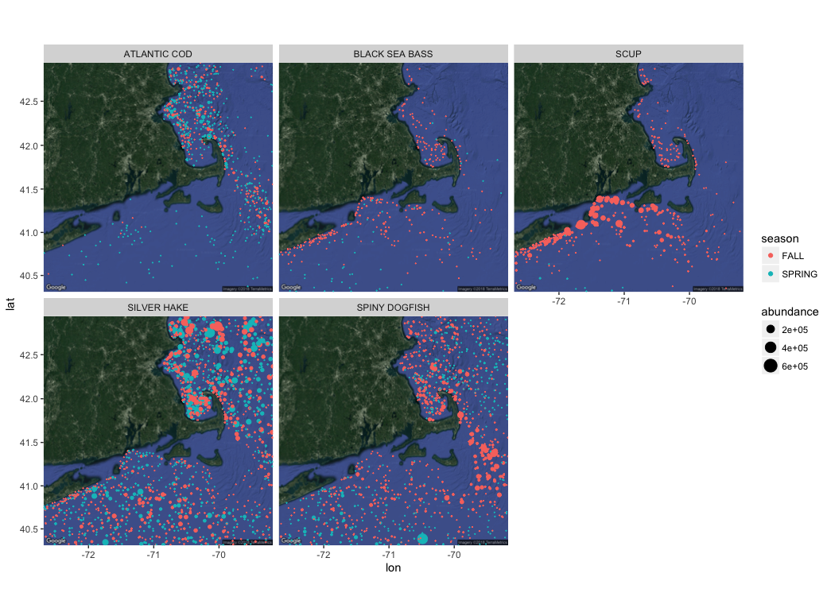
Visualizing fishery survey data
NMFS bottom trawl surveys
(data from http://oceanadapt.rutgers.edu/)

Slide 10
Let’s go!
Switch to R

